Slide 1

Udemy Data Analysis
By Emmanuel Ngongo

Slide 2

Project Description:
To better understand the pricing and subscriptions data of Udemy courses (for four different subjects) and identifying trends and patterns
This will help us to:
Identify for which subject more courses should be created
Create targeted strategies to increase the company revenue

Slide 3
Key questions:
What are the total numbers of subscribers in each subject?
How does the average content duration/price/number of students vary across different subjects?
How many courses are free and paid for each subject?
What is the average price of web development courses at different levels?
What are the 20 most popular courses? Also, include the following information: - Their level - Whether they are free or paid - Whether any are free beginner courses, - and the duration of the courses.
Does content duration impact the price of the course?

Slide 4
Findings & Insights

Slide 5
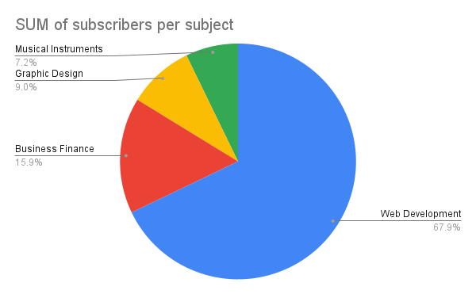
What are the total numbers of subscribers in each subject?
Add visualizations here

Slide 6
BRIEF SUMMARY
The most popular subject in Udemy is web development and represents 67.9% of the total subscribers.

Slide 7
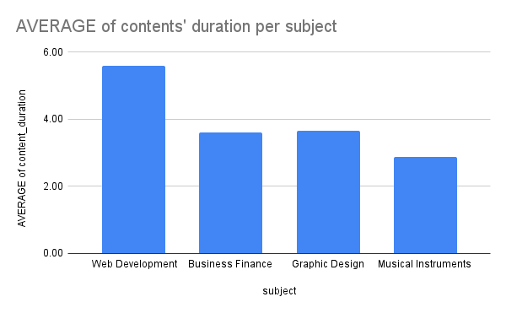
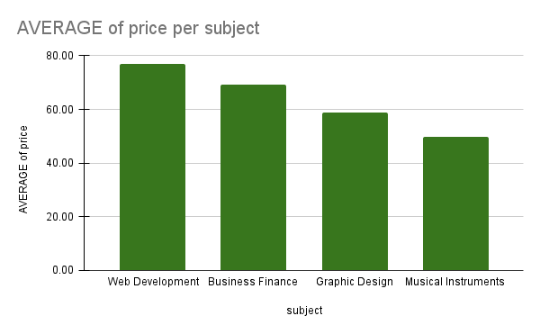
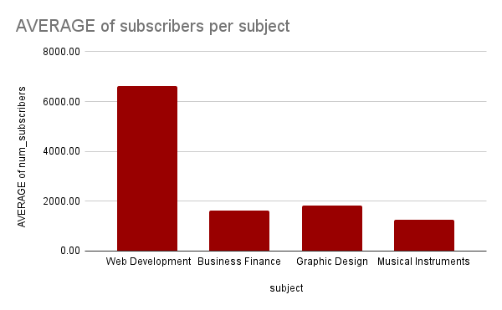
2. How does the average content duration/price/number of students vary across different subjects?

Slide 8
BRIEF SUMMARY
By looking at the column chart for the average content duration, price and subscribers per subject we have a clear insight of the average price, content duration and also the number of subscribers, are the highest for web development.
In the average content duration per subject the graphic design takes the second place after web development, while business finance comes at the third place and musical instrument comes last.
By observing the average of price per subject, business finance is the second with an average price of 69.08, graphic design is the third (58.77) and Musical instruments is the last (49.65).
By observing the average of subscribers column graph, we notice that the web development subject has a massive amount of subscribers of 6635.02 subscribers compared to the other subjects, while respectively graphic design has an average of 1617.93, followed by business finance which has 1617.93 subscribers and musical instruments subject which has 1265.60 subscribers.

Slide 9
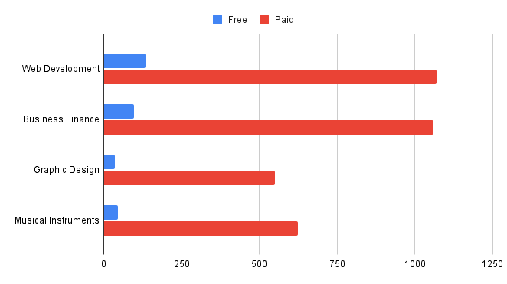
3. How many courses are free and paid for each subject?

Slide 10
BRIEF SUMMARY
Web development and business finance have more courses which are free and paid than the rest.
Web development has a total of 1203 courses which 134 are free and 1069 are paid courses.
Business finance has a total 1155 courses which 96 are free and 1059 are paid courses.
Graphic design has a total of 584 courses which 549 are paid courses and 35 are free courses.
Musical instruments has 669 courses in total, made of 46 free courses and 623 paid courses.
Web development and business finance’s courses represent almost 60% of the all courses combined in the database.

Slide 11
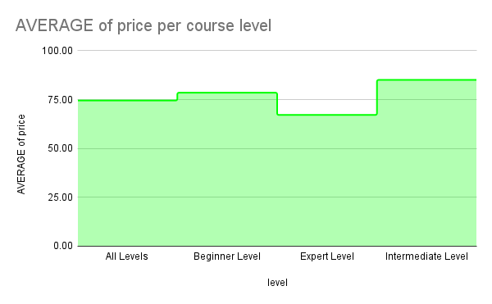
4. What is the average price of web development courses at different levels?

Slide 12
BRIEF SUMMARY
The intermediate level has a higher average price of 85.07 , followed by the beginner level with an average price of 78.54, followed by all level and expert level with an average price of 74.55 and 67.14.

Slide 13
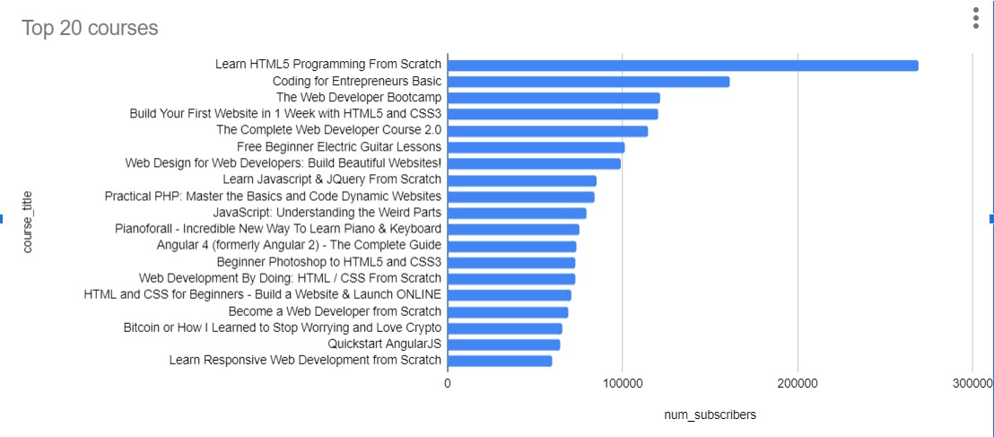
5. What are the 20 most popular courses?

Slide 14
BRIEF SUMMARY
Due to the picture above we can notice that the course title “Learn HTML5 programming from scratch” is the most popular based on the number of subscribers which are 268923, followed by “Coding for Entrepreneurs Basic” that has 161029 subscribers and the list goes on until the twentieth course “Learn Responsive Web Development from Scratch”.

Slide 15
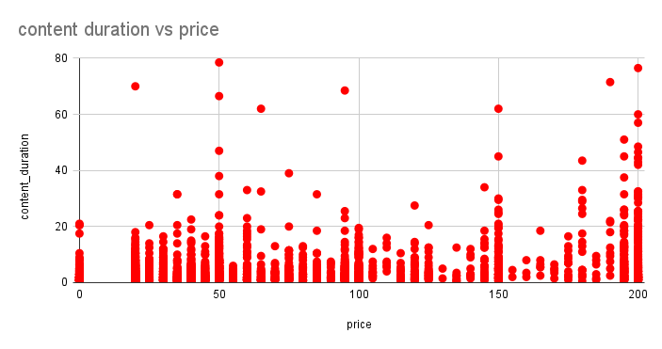
6. Does content duration impact the price of the course?

Slide 16
BRIEF SUMMARY
By looking at the graph we can notice that most of the courses have a content duration of 20 hours or less, and a few courses have more than 40 hours of content duration.
The content duration is not affected by the price because we notice there is a course that has a length of 76.50 and its price is 200 at the same time there is also a course that has a length of 78.50 and its price is 50, from these facts we can deduct that the price is not affected by the length of content duration.

Slide 17
Summary

Slide 18
Summary of findings:
Top 5 courses:
Almost 68% of subscribers come from Web Development and the top 5 courses are for Web development as well
Business Finance vs Web Development:
Business Finance and web development have almost equal number of total courses (1155 vs 1203), but web development course are almost 2x in content duration and have 4x the average subscribers
Course Pricing:
The course subscription does not seem to be impacted by the price because web development courses have the highest number of subscribers while having the highest price at the same time.

Slide 19
Actions & Recommendations

Slide 20
Recommended actions:
Product recommendations:
Focus on getting more paid course by creators in web development field hence this is the most popular subject in udemy.
Marketing recommendations:
Our data tells us that our web development courses are most popular and people are willing to pay for it. Marketing and advertising campaigns should therefore focus on advertising more web development contents.

Slide 21
Thank you!

